Slide 1

Understanding Health Insurance Data
SREELAKSHMI P G
(DATA ANALYTICS)

Slide 2

Data Overview
This presentation delves into a dataset of 2017 health insurance charges from the U.S. , providing insights into demographic patterns, health metrics, and key factors influencing costs.
Dataset Scope
Features
The dataset contains 1,338 records with 7 features.
Age, sex, region, BMI, smoker status, children, insurance charges.

Slide 3
Analyzing Health Insurance Data
Goal
Approach
To gain a comprehensive understanding of the factors that contribute to health insurance charges of the U.S.
We will analyze the dataset using statistical methods to identify relationships and trends.

Slide 4

Demographic Insights
Age Distribution
Gender Breakdown
The dataset shows a wide range of ages, with a focus on young adults.
The dataset exhibits an even split between males and females.
Regional Variation
The data includes individuals from diverse regions of the U.S. , providing insights into geographical differences.

Slide 5



Trends in Health Metrics
BMI
Smoker Status
A higher BMI is associated with higher insurance charges, reflecting potential health risks.
Smokers, as expected, have significantly higher insurance costs due to increased health risks.

Slide 6

Relationship Between Features
1
Age and Charges
Average claim amounts are highest for younger individuals (18-20 years) and decline slightly with age before stabilizing.
2
BMI and Charges
A strong relationship exists between BMI and charges, suggesting higher health risks.
3
Smoker Status and Charges
Smokers consistently incur much higher insurance costs, highlighting the impact of lifestyle choices.

Slide 7
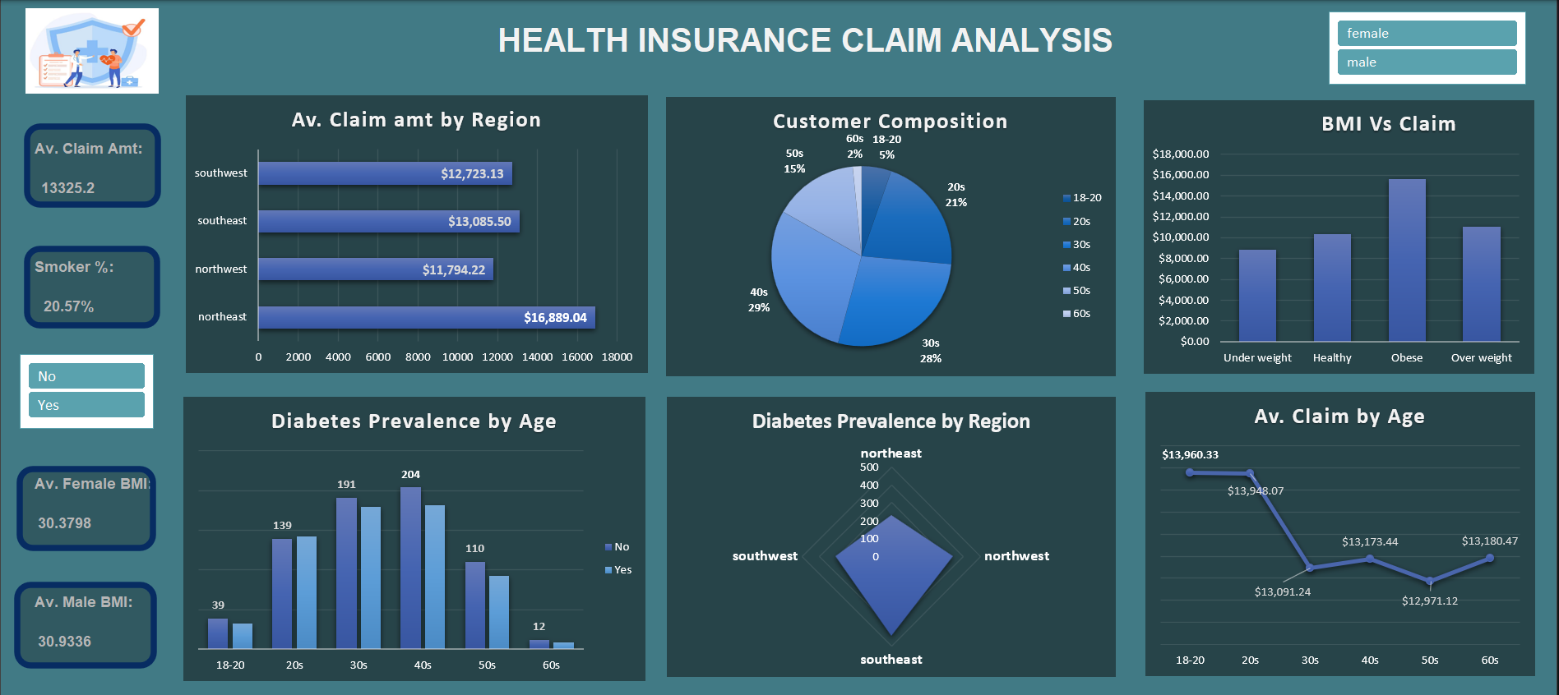
Dashboard Preview

Slide 8




Opportunities for Intervention
Health Education
Promote healthy lifestyle choices, focusing on weight management and smoking cessation.
Targeted Programs
Develop programs addressing specific health risks identified in the data.
Policy Initiatives
Explore policies that incentivize healthier behaviors and reduce health risks.

Slide 9
Conclusion
Claim Amount by Region:
The northeast region has the highest average claim amount, while the northwest region has the lowest.
Smoker Impact:
20.57% of the insured individuals are smokers, likely contributing significantly to higher average claim amounts due to smoking-related health issues.
BMI Influence:
Individuals with obese BMI have the highest average claim amounts, indicating a strong link between obesity and higher healthcare costs.
Client Demographics:
Most customers are in their 30s and 40s forming the majority of the customer base.
Diabetes Prevalence:
Diabetes is most prevalent in individuals aged 30-50 years, with the southeast region leading in diabetes cases compared to other regions.
Age vs. Claim Amount:
Average claim amounts are highest for younger individuals (18-20 years) and decline slightly with age before stabilizing.
Gender BMI:
The average BMI for females (30.38) and males (30.93) is similar, indicating similar risk factors between genders

Slide 10
Recommendations
Focus on preventive health measures, especially for smokers and obese individuals.
Target diabetes management programs in the southeast region.
Explore opportunities for cost control in the northeast region with higher claim averages.
Develop tailored health programs for individuals in their 30s and 40s, the largest age group
Notes:
Awareness,Cost control,Diabetes mngmnt,Obesity and smoking

Slide 11
Reference and Methodology
This dataset was sourced from Kaggle, a popular platform for data science and machine learning projects.
Data analysis was conducted using Excel statistical software, including descriptive statistics, correlation analysis, and visualization techniques.
Excel is a powerful spreadsheet application used for organizing, analyzing, and visualizing data with tools like formulas, charts, and pivot tables.

Slide 12
Thank You…

